Slide 1
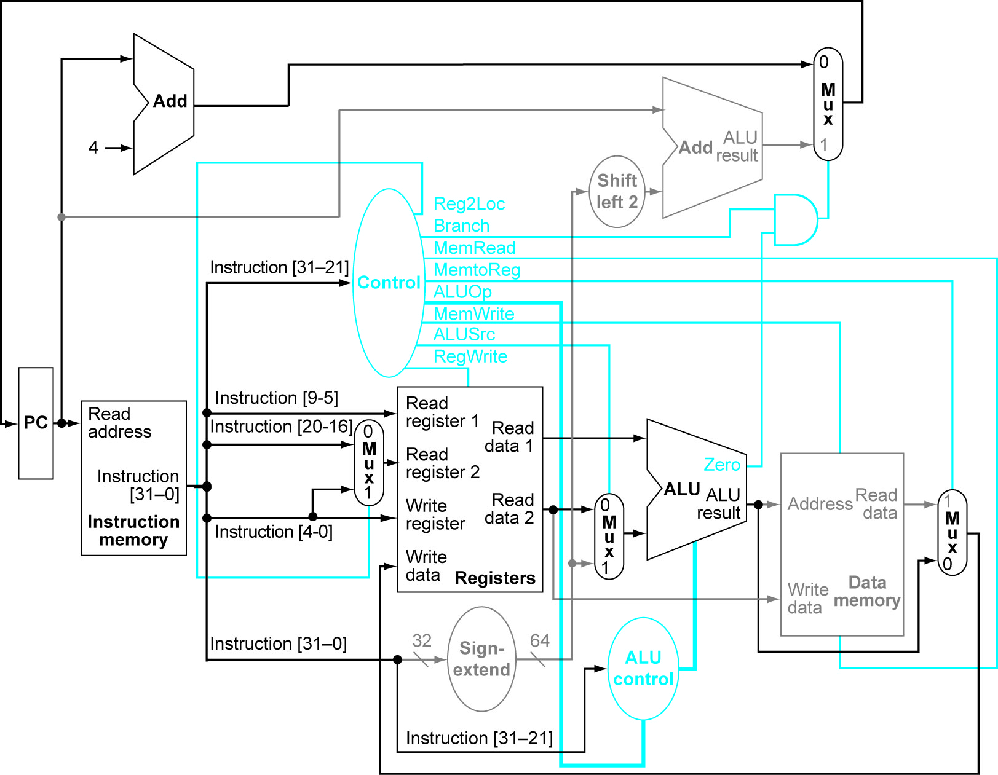
Notes:
Figure 4.18 Datapath in operation for R-type instruction

Slide 2
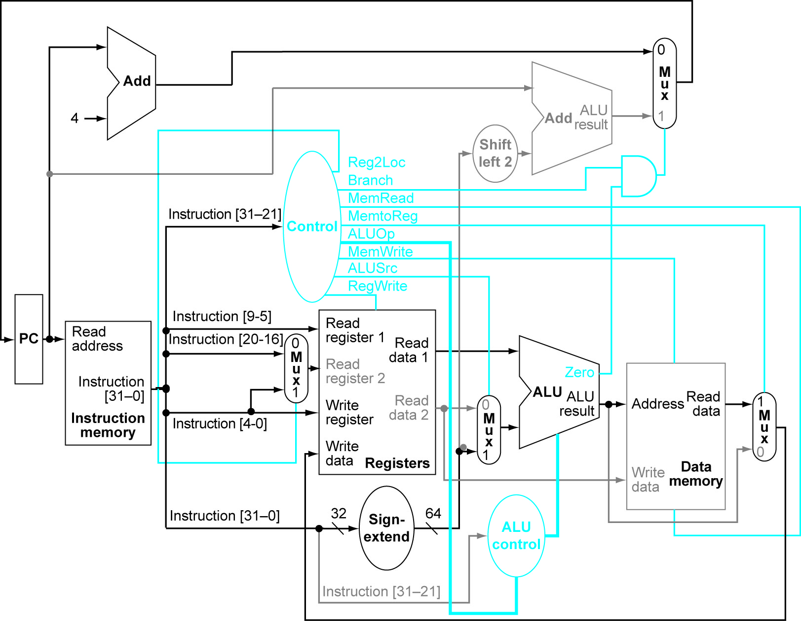
Notes:
Figure 4.20 Load operation

Slide 3
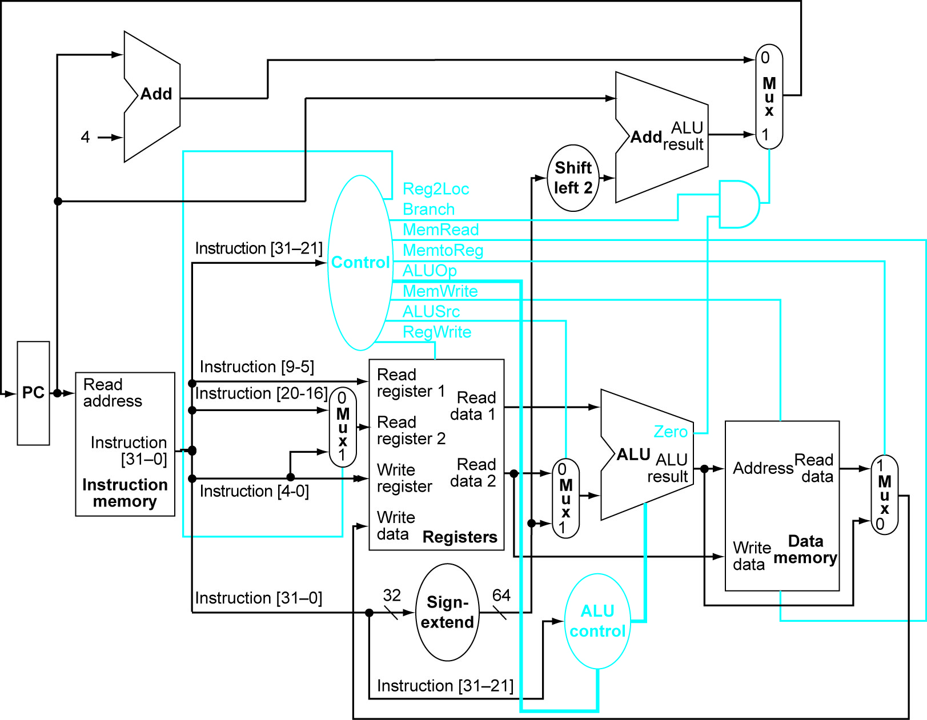
Notes:
Figure 4.17 Simple Data Path

Slide 4
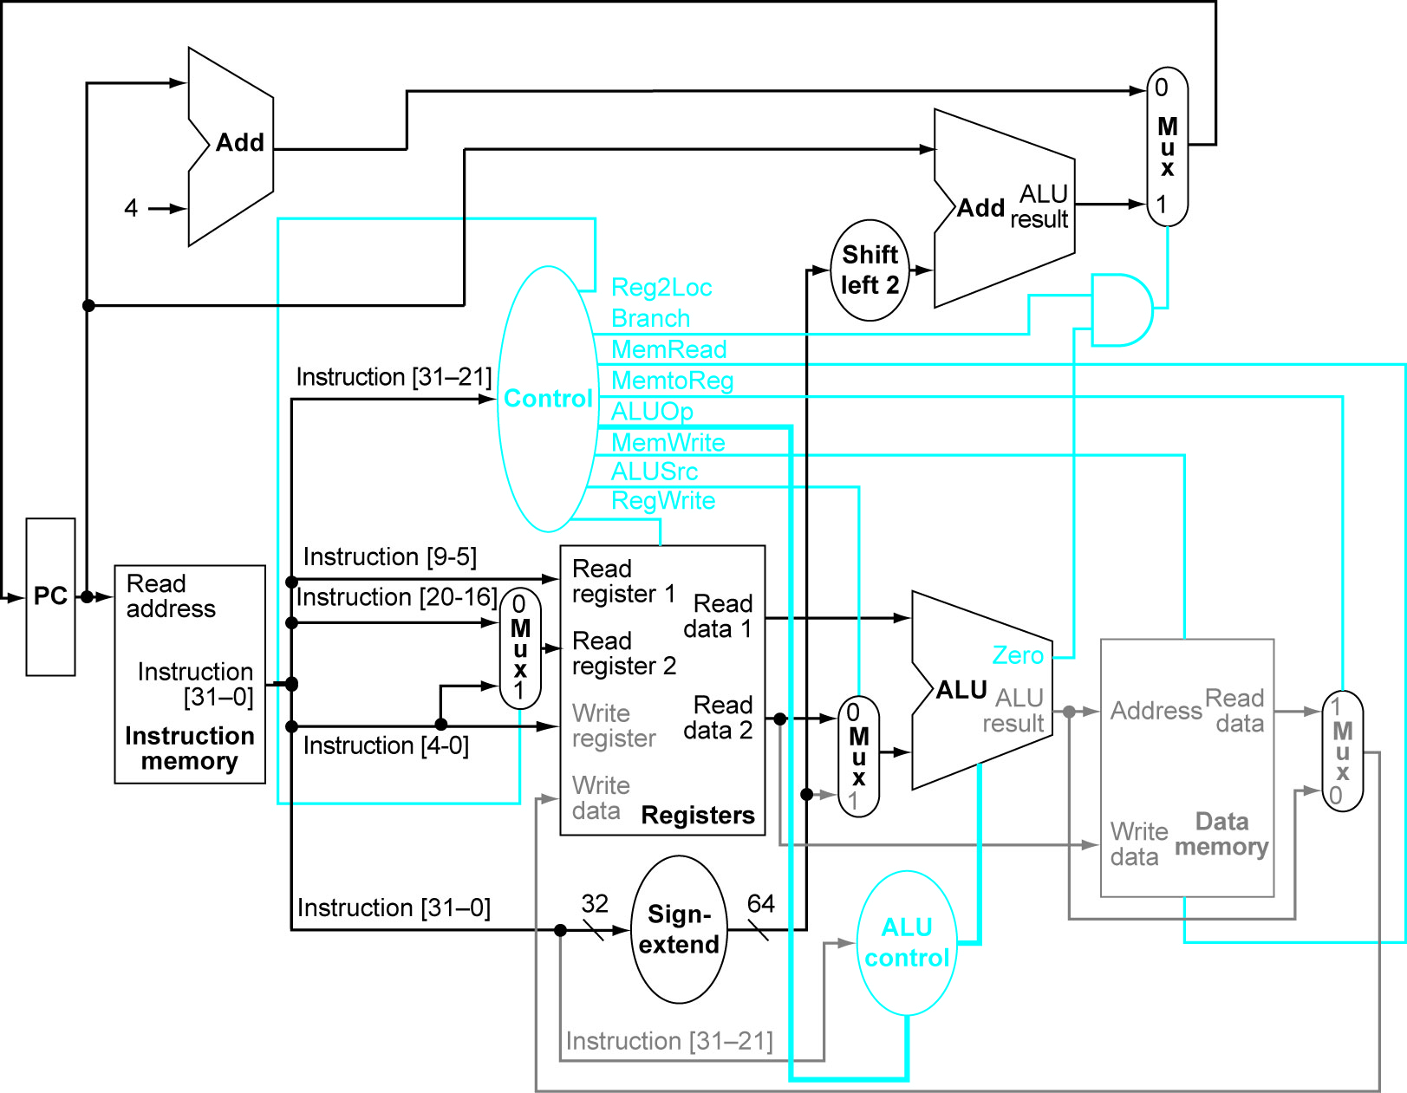
Notes:
Figure 4.21 compare and branch instruction

Slide 5
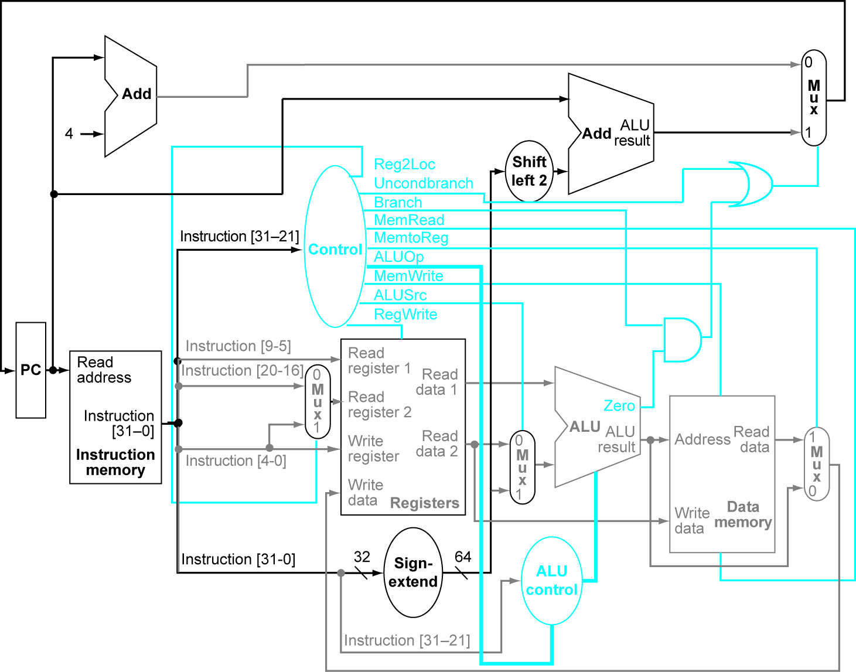
Notes:
Figure 4.23 additional or gate for unconditional branch.

